Slide 1
Module 3 Work – Mar 28
Agenda
Software Accessibility Presentations
Alisha, Gursimrat, Khushi
Marks Spreadsheet
Student Updates / Interviews
Module Work
Module A.3: Dream Machine
Module B.3: Intermediate Python Programming
Upcoming
Monday April 1 : Dream Machine Brochure DUE (End of Class)
Tuesday April 2 : Dream Machine Trade Show
April 8 & 9 : Mid-Term Test

Slide 2


Dream Machine A.3
Level 3: Building Your Machine
Identify / Prioritize Options
Establish a Budget
Order On-Line

Slide 3

Dream Machine A.3
Level 4: Sharing Your Machine
Create a Brochure
Present at Trade Show

Slide 4
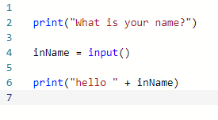
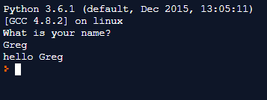
Python Input

